Slide 1
Java Programming
Events, AWT, and Swing

Slide 2
Contents
Events and Delegation Model
Overview of the AWT
Button and JButton
Canvas
Dialog and FileDialog
Frame and JFrame
Label and JLabel
Layout Managers
List
Menu, MenuBar and MenuItem
Panel
TextField

Slide 3
Event Handling
An event is an object that describes some state change in a source
Each time a user interacts with a component an event is generated, e.g.:
  A button is pressed
  A menu item is selected
  A window is resized
  A key is pressed
An event informs the program about the action that must be performed

Slide 4
The Delegation Event Model
Provides a standard mechanism for a source to generate an event and send it to a set of listeners
A listener receives event notifications
A listener must:
  Register for specific events
  Implement an interface to receive those events
  Unregister if those events are not needed any longer
Listener
container
Source
Listener
events
Listener

Slide 5
Event Class Hierarchy
Object
EventObject
AWTEvent
ActionEvent
ComponentEvent
ItemEvent
TextEvent
FocusEvent
InputEvent
WindowEvent
KeyEvent
MouseEvent

Slide 6
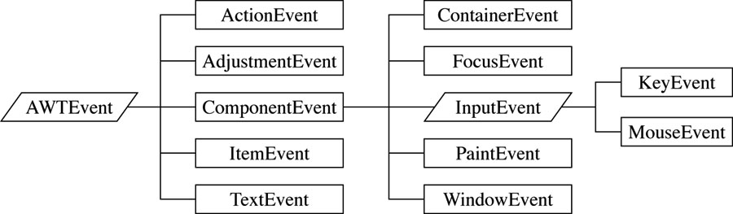
Event Event Class HierarchyHierarchy
Events in Java are defined by subclasses of the AWTEvent abstract class.

Slide 7
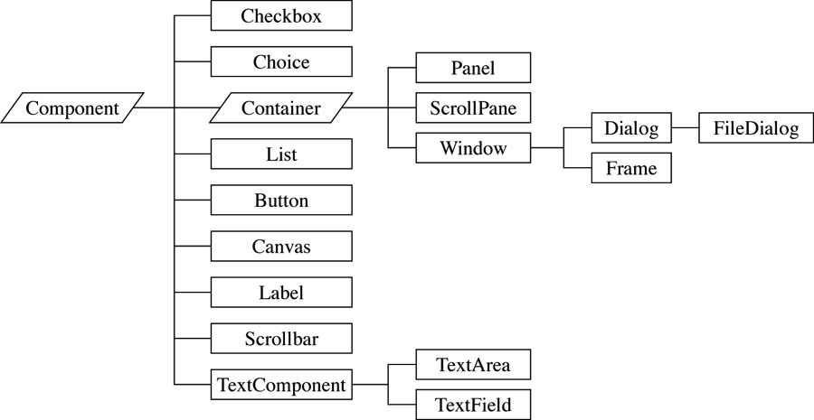
Sources of Event

Slide 8
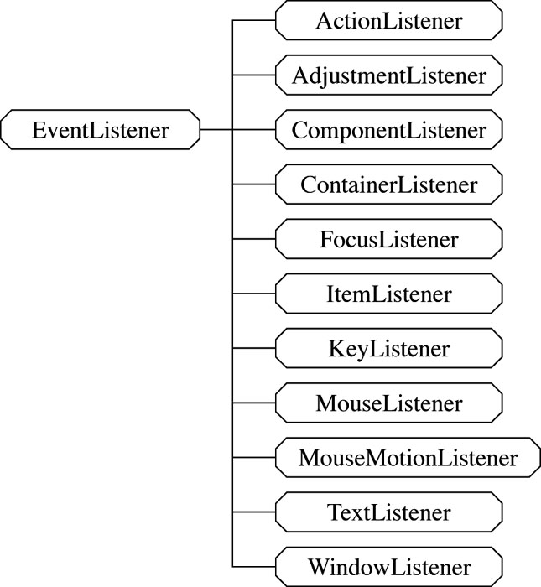
Event Listeners
To respond to events we need to implement special methods called handlers.
Each class of events predefines the names of the handlers that can be written for it…

Slide 9
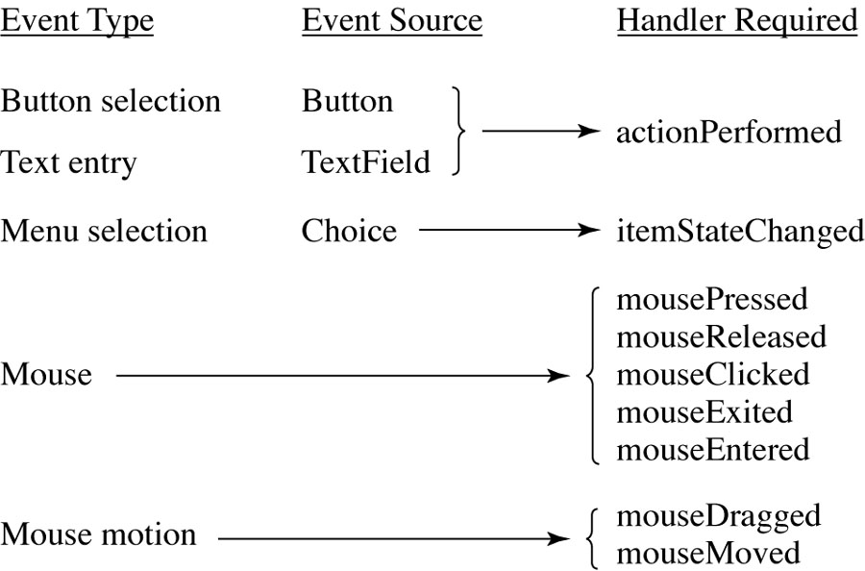
Handlers Required for Button, Menu,Text Typing, and Mouse Events

Slide 10
Event Class | Listener Interface | Listener Methods
ActionEvent | ActionListener | actionPerformed()
AdjustmentEvent | AdjustmentListener | adjustmentValueChanged()
ComponentEvent | ComponentListener | componentHidden()
 |  | componentMoved()
 |  | componentResized()
 |  | componentShown()

Slide 11
ContainerEvent | ContainerListener | componentAdded()
 |  | componentRemoved()
FocusEvent | FocusListener | focusGained()
 |  | focusLost()
ItemEvent | ItemListener | itemStateChanged()
KeyEvent | KeyListener | keyPressed()
 |  | keyReleased()
 |  | keyTyped()
MouseEvent | MouseListener | mouseClicked()
 |  | mouseEntered()
 |  | mouseExited()
 |  | mousePressed()
 |  | mouseReleased()
 | _ | _
 | MouseMotionListener | mouseDragged()
 |  | mouseMoved()

Slide 12
TextEvent | TextListener | textValueChanged()
WindowEvent | WindowListener | windowActivated()
 |  | windowClosed()
 |  | windowClosing()
 |  | windowDeactivated()
 |  | windowDeiconified()
 |  | windowIconified()
 |  | windowOpened()

Slide 13
Button Example
Container
  Component in AWT that can contain another components like buttons, textfields, labels etc.
Window
  Is the container that have no borders and menu bars
Panel
  Is the container that doesn't contain title bar and menu bars
Frame
  Is the container that contain title bar and can have menu bars

Slide 14
Button Example
import java.awt.Button;
import java.applet.Applet;
import java.awt.event.ActionListener;
import java.awt.event.ActionEvent;
import java.awt.Component;
/*<applet code=AButton.class width=100 height=100>
</applet> */
public class AButton extends Applet implements ActionListener {
public void init() {
// STEP 1: Compose the GUI
Button beepButton = new Button("Beep");
add(beepButton);
// STEP 2: Setup Event handlers
beepButton.addActionListener(this);
// STEP 3: Display the GUI (automatic -- this is an applet)
}
public void actionPerformed(ActionEvent event) {
Component c = (Component)event.getSource();
c.getToolkit().beep();
} }

Slide 15
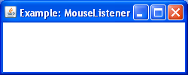
MouseListener
import java.awt.*;
import java.awt.event.*;
class MLF extends Frame implements MouseListener {
MLF()
{
super("Example: MouseListener");
addMouseListener(this);
setSize(250,100);
}
public void mouseClicked(MouseEvent me)
{
}
public void mouseEntered(MouseEvent me)
{
}
public void mouseExited(MouseEvent me)
{
}
public void mousePressed(MouseEvent me)
{
}
public void mouseReleased(MouseEvent me)
{
System.out.println(me);
}
public static void main(String[] args)
{
new MLF().setVisible(true);
}
}
The MouseListener interface defines the methods to receive mouse events
A listener must register to receive mouse events
Mouse click
MouseEvent

Slide 16


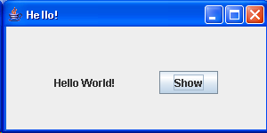
Using the ActionListener
Stages for Event Handling by ActionListener
  First, import event class
    import java.awt.event.*;
  Define an overriding class of event type (implements ActionListener)
  Create an event listener object
    ButtonListener bt = new ButtonListener();
  Register the event listener object
    b1 = new Button(“OK”);
    b1.addActionListener(bt);
Button Click Event
①
Class ButtonListener implements ActionListener {
public void actionPerformed(ActionEvent e) {
// Write what to be done. . .
label.setText(“Hello World!”);
}
}
ButtonListener
action
addActionListener
②

Slide 17
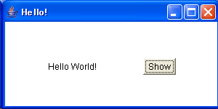
A Hello Example Using Button Listener
import java.awt.*;
import java.awt.event.*;
public class HelloAWT extends Frame { // Using Frame
Label contents;
Button dispbutton;
public HelloAWT() { // Constructor
setLayout(new FlowLayout(FlowLayout.CENTER, 50, 50));
contents = new Label(" "); // Create Label object
add(contents); // Add the label to this Frame
dispbutton = new Button("Show"); // Create Button object
dispbutton.addActionListener(new DispButtonListener()); // Add Event Listener
add(dispbutton); // Add the button object to this Frame
}
class DispButtonListener implements ActionListener { // Event Listener
public void actionPerformed(ActionEvent e) { // What to do when the button is clicked
contents.setText("Hello World!");
}
}
public static void main (String[] args) {
HelloAWT f = new HelloAWT(); // Create Hello GUI
f.setTitle("Hello!");
f.setSize(400,150);
f.setVisible(true);
}
} // end of “HelloAWT.java”
Run:
Java HelloAWT

Slide 18
Adapter classes
Adapter classes are fully abstract classes that correspond to listener interfaces.
They are extended (not implemented) and thus you can ignore methods that do not interest you.
You can use them instead of listeners in the case that only some of the methods of the interface are to be used. You don’t use the abstract specifier and of course you cannot use multiple inheritance.
Some adapter classes:
  KeyAdapter
  MouseAdapter
  MouseMotionAdapter

Slide 19
Overview
The Abstract Window Toolkit (AWT) and Swing provide standard components to build a graphical user interface (GUI)
The GUI enables interaction between the user and the program by using the mouse, keyboard, or another input device
AWT also provides a mechanism to paint different shapes on the screen (e.g., lines, rectangles, text, etc.)

Slide 20
AWT (Abstract Window Toolkit)
Present in all Java implementations
Described in (almost) every Java textbook
Adequate for many applications
Uses the controls defined by your OS
  therefore it's "least common denominator"
Difficult to build an attractive GUI
import java.awt.*;

Slide 21


Abstract Window Toolkit
The AWT is roughly broken into three categories
  Components
  Layout Managers
  Graphics
Many AWT components have been replaced by Swing components
It is generally not considered a good idea to mix Swing components and AWT components. Choose to use one or the other.

Slide 22
Swing
Requires Java 2 or a separate (huge) download
More controls, and they are more flexible
Gives a choice of “look and feel” packages
Much easier to build an attractive GUI
import javax.swing.*; // Mac or PC
import com.sun.java.swing.*; // UNIX

Slide 23
Swing vs. AWT
Swing is more flexible and better looking
Swing and AWT are incompatible--you can use either, but you can’t mix them
Learning the AWT is a good start on learning Swing
AWT: Button b = new Button (“OK”);
Swing: Jbutton b = new Jbutton(“OK”);

Slide 24
Java AWT | Java Swing
AWT components are platform-dependent. | Java swing components are platform-independent.
AWT components are heavyweight. | Swing components are lightweight.
AWT doesn't support pluggable look and feel. | Swing supports pluggable look and feel.
AWT provides less components than Swing. | Swing provides more powerful components such as tables, lists, scrollpanes, colorchooser, tabbedpane etc.
AWT doesn't follows MVC(Model View Controller) where model represents data, view represents presentation and controller acts as an interface between model and view. | Swing follows MVC

Slide 25
To build a GUI...
Make somewhere to display things--a Frame, a Window, or an Applet
Create controls (buttons, text areas, etc.)
Add your controls to your display area
Arrange, or lay out, your controls
Attach Listeners actions to your controls

Slide 26
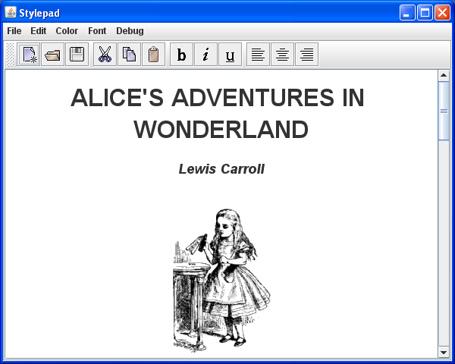
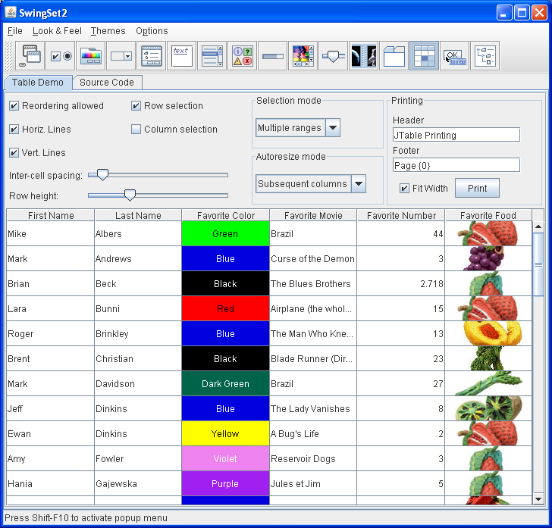
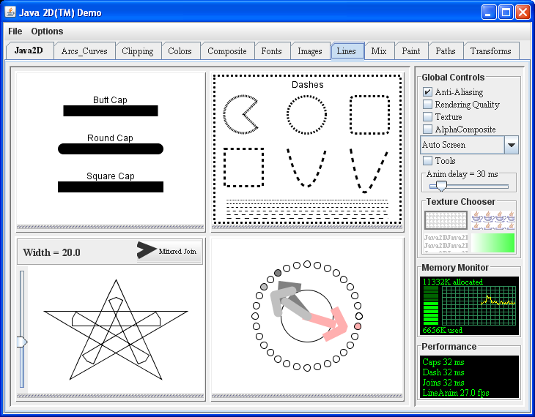
Example: GUI

Slide 27
AWT Class Hierarchy
Object
Component
MenuComponent
Button
Canvas
Container
Label
List
Scrollbar
MenuBar
MenuItem
TextComponent
Window
Panel
Menu
TextField
TextArea
Frame
Dialog
Applet
FileDialog

Slide 28
AWT Class Hierarchy
Component
Container
Window
Frame
Button
Panel
List
Checkbox
Choice
Label
TextComponent
TextField
TextArea

Slide 29
Component
A component is an object having a graphical representation
Component is an abstract class
Components can be displayed on the screen
Components allow the user to interact with the program
The Component class defines data and methods which are relevant to all Components
  setBounds
  setSize
  setLocation
  setFont
  setEnabled
  setVisible
  setForeground -- colour
  setBackground -- colour

Slide 30
Example: Frame
import java.awt.*;
public class AwtFrame{
public static void main(String[] args)
{
Frame frm = new Frame("Java AWT Frame");
Label lbl = new Label("Welcome to Islamic university”,Label.CENTER);
frm.add(lbl);
frm.setSize(400,400);
frm.setVisible(true);
}
}

Slide 31
Constructing a Panel
Construct the panel (new Panel()).
Give the panel a layout manager (setLayout())
Populate the panel (add())
Add the panel to its own container (add()).

Slide 32
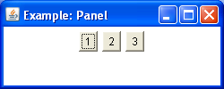
Panel
Panel is the simplest container class
A panel provides space in which an application can attach any other component, including other panels
The default layout manager for a panel is the FlowLayout manager
import java.awt.*;
import java.awt.event.*;
class PNL extends Frame {
PNL()
{
super("Example: Panel");
Panel p = new Panel();
p.add(new Button("1"));
p.add(new Button("2"));
p.add(new Button("3"));
add(p);
setSize(250,100);
}
public static void main(String[] args)
{
new PNL().setVisible(true);
}
}

Slide 33
Container
Container is a subclass of Component. (ie. All containers are themselves, Components)
Containers contain components
For a component to be placed on the screen, it must be placed within a Container
The Container class defined all the data and methods necessary for managing groups of Components
      Add
      getComponent
      getMaximumSize
      getMinimumSize
      getPreferredSize
      Remove
      removeAll

Slide 34
Windows and Frames
The Window class defines a top-level Window with no Borders or Menu bar.
  Usually used for application splash screens
Frame defines a top-level Window with Borders and a Menu Bar
  Frames are more commonly used than Windows
Once defined, a Frame is a Container which can contain Components
Frame aFrame = new Frame(“Hello World”);
aFrame.setSize(100,100);
aFrame.setLocation(10,10);
aFrame.setVisible(true

Slide 35
Buttons
This class represents a push-button which displays some specified text.
When a button is pressed, it notifies its Listeners. (More about Listeners in the next chapter).
To be a Listener for a button, an object must implement the ActionListener Interface.
Panel aPanel = new Panel();
Button okButton = new Button("Ok");
Button cancelButton = new Button("Cancel");
aPanel.add(okButton));
aPanel.add(cancelButton));

Slide 36
Labels
This class is a Component which displays a single line of text.
Labels are read-only. That is, the user cannot click on a label to edit the text it displays.
Text can be aligned within the label
Label aLabel = new Label("Enter password:");
aLabel.setAlignment(Label.RIGHT);
aPanel.add(aLabel);

Slide 37
Lists
This class is a Component which displays a list of Strings.
The list is scrollable, if necessary.
Sometimes called Listbox in other languages.
Lists can be set up to allow single or multiple selections.
The list will return an array indicating which Strings are selected
List aList = new List();
aList.add("Edmonton");
aList.add("Regina");
aList.add("Vancouver");
aList.setMultipleMode(true);

Slide 38
Checkboxes
This class represents a GUI checkbox with a textual label.
The Checkbox maintains a boolean state indicating whether it is checked or not.
If a Checkbox is added to a CheckBoxGroup, it will behave like a radio button.
Checkbox creamCheckbox = new CheckBox("Cream");
Checkbox sugarCheckbox = new CheckBox("Sugar");

Slide 39
Choices
This class represents a dropdown list of Strings.
Similar to a list in terms of functionality, but displayed differently.
Only one item from the list can be selected at one time and the currently selected element is displayed.
Choice aChoice = new Choice();
aChoice.add("Calgary");
aChoice.add("Edmonton");
aChoice.add("Alert Bay");
String selectedDestination= aChoice.getSelectedItem();

Slide 40
TextField
This class displays a single line of optionally editable text.
This class inherits several methods from TextComponent.
This is one of the most commonly used Components in the AWT
TextField emailTextField = new TextField();
TextField passwordTextField = new TextField();
passwordTextField.setEchoChar("*");
[…]
String userEmail = emailTextField.getText();
String userpassword = passwordTextField.getText();

Slide 41
TextArea
This class displays multiple lines of optionally editable text.
This class inherits several methods from TextComponent.
TextArea also provides the methods: appendText(), insertText() and replaceText()
// 5 rows, 80 columns
TextArea fullAddressTextArea = new TextArea(5, 80);
String userFullAddress= fullAddressTextArea.getText();

Slide 42
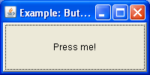
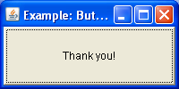
Button
import java.awt.*;
import java.awt.event.*;
class BTN extends Frame {
BTN()
{
super("Example: Button");
final Button b = new Button("Press me!");
// an anonymous class
b.addActionListener(new ActionListener() {
// the event handler
public void actionPerformed(ActionEvent ae) {
b.setLabel("Thank you!"); }
});
add(b);
setSize(200,100);
}
public static void main(String[] args)
{
new BTN().setVisible(true);
}
}
A Button is a component that simulates the appearance of a push button
When the user presses the mouse inside a button an ActionEvent is generated
Mouse click
ActionEvent

Slide 43
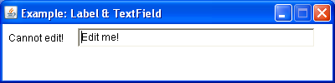
Label and TextField
A Label displays a string that cannot be changed by a user
A TextField allows a user to enter or edit one line of text
A FlowLayout arranges components :
  in a directional flow (left-to-right, or right-to-left)
  horizontally until no more components fit on the same line
import java.awt.*;
import java.awt.event.*;
class LTF extends Frame {
LTF()
{
super("Example: Label & TextField");
setLayout(new FlowLayout(FlowLayout.LEFT));
setResizable(false);
add(new Label("Cannot edit!"));
final TextField tf = new TextField("Edit me!",37);
tf.addTextListener(new TextListener() {
public void textValueChanged(TextEvent te)
{
System.out.println(te.paramString());
}
});
add(tf);
setSize(400,100);
}
public static void main(String[] args)
{
new LTF().setVisible(true);
}
}

Slide 44
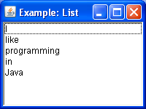

List
I
mport java.awt.*;
import java.awt.event.*;
class LST extends Frame {
LST()
{
super("Example: List");
final List l = new List();
l.add("I");
l.add("like");
l.add("programming");
l.add("in");
l.add("Java");
l.addItemListener(new ItemListener() {
public void itemStateChanged(ItemEvent ie)
{
System.out.println(ie.paramString());
}
});
add(l);
setSize(200,150);
}
public static void main(String[] args)
{
new LST().setVisible(true);
}
}
The List component presents the user with a scrolling list of text items
It can be set up so that the user can choose either one item or multiple items
Mouse click

Slide 45
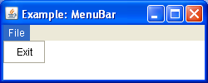
Menu, MenuBar and MenuItem
import java.awt.*;
import java.awt.event.*;
class MNB extends Frame {
MNB()
{
super("Example: MenuBar");
final MenuBar mb = new MenuBar();
setMenuBar(mb);
final Menu m = new Menu("File");
MenuItem mi;
mi = new MenuItem("Exit");
mi.addActionListener(new ActionListener() {
public void actionPerformed(ActionEvent ae)
{
System.exit(0);
}
});
m.add(mi);
mb.add(m);
setSize(250,100);
}
public static void main(String[] args)
{
new MNB().setVisible(true);
}
}
A frame may contain a menu bar with options (i.e. items)
When the mouse is clicked on an option a drop down menu appears
Each menu consists of one or more menu items

Slide 46
Layout Managers
A layout manager helps in arranging the components in a container
Each layout manager:
  Encapsulates an algorithm for positioning and sizing of components
  Automatically calculates the coordinates of each component it manages
  If a container is resized, the layout manager readjusts the placement of the components

Slide 47
FlowLayout
Use add (component); to add to a component using a FlowLayout
Components are added left-to-right
If no room, a new row is started
Exact layout depends on size of Applet
Components are made as small as possible
FlowLayout is convenient but often ugly

Slide 48

FlowLayout Demo

Slide 49
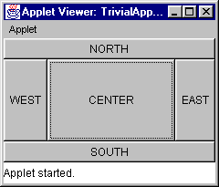
BorderLayout
At most five components can be added
If you want more components, add a Panel, then add components to it.
setLayout (new BorderLayout());
add (BorderLayout.NORTH, new Button(“NORTH”));

Slide 50
BorderLayout with five Buttons
public void init() {
setLayout (new BorderLayout ());
add (BorderLayout.NORTH, new Button ("NORTH"));
add (BorderLayout.SOUTH, new Button ("SOUTH"));
add (BorderLayout.EAST, new Button ("EAST"));
add (BorderLayout.WEST, new Button ("WEST"));
add (BorderLayout.CENTER, new Button ("CENTER"));
}

Slide 51
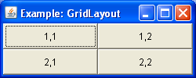
GridLayout
Automatically arranges components in a grid of rows and columns
The container is divided into equal-sized cells, and one component is placed in each cell
import java.awt.*;
import java.awt.event.*;
class GLM extends Frame {
GLM()
{
super("Example: GridLayout");
setLayout(new GridLayout(2,2));
add(new Button("1,1"));
add(new Button("1,2"));
add(new Button("2,1"));
add(new Button("2,2"));
setSize(250,100);
}
public static void main(String[] args)
{
new GLM().setVisible(true);
}
}

Slide 52
Other Layout Managers
GridBag Layout Manager
Card Layout Manager
No Layout Manager
Use Insets getInsets(); method to inset some space between container and enclosing window

Slide 53
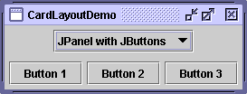
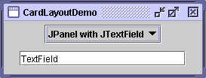
CardLayout
lets you implement an area that contains different components at different times. A CardLayout is often controlled by a combo box, with the state of the combo box determining which panel (group of components) the CardLayout displays

Slide 54
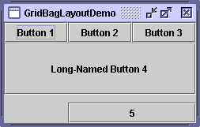
GridBagLayout
is a sophisticated, flexible layout manager. It aligns components by placing them within a grid of cells, allowing some components to span more than one cell.

Slide 55
GridBagLayout
Behavior
  Divides the window into grids, without requiring the components to be the same size
    About three times more flexible than the other standard layout managers, but nine times harder to use
  Each component managed by a grid bag layout is associated with an instance of GridBagConstraints
    The GridBagConstraints specifies:
      How the component is laid out in the display area
      In which cell the component starts and ends
      How the component stretches when extra room is available
      Alignment in cells

Slide 56
GridBagLayout: Basic Steps
Set the layout, saving a reference to it
GridBagLayout layout = new GridBagLayout();
setLayout(layout);
Allocate a GridBagConstraints object
GridBagConstraints constraints =
new GridBagConstraints();
Set up the GridBagConstraints for
component 1
constraints.gridx = x1;
constraints.gridy = y1;
constraints.gridwidth = width1;
constraints.gridheight = height1;
Add component 1 to the window, including constraints
add(component1, constraints);
Repeat the last two steps for each remaining component

Slide 57
GridBagConstraints
Copied when component added to window
Thus, can reuse the GridBagConstraints
GridBagConstraints constraints = new GridBagConstraints();
constraints.gridx = x1;
constraints.gridy = y1;
constraints.gridwidth = width1;
constraints.gridheight = height1;
add(component1, constraints);
constraints.gridx = x1;
constraints.gridy = y1;
add(component2, constraints);

Slide 58
GridBagConstraints Fields
gridx, gridy
  Specifies the top-left corner of the component
  Upper left of grid is located at (gridx, gridy)=(0,0)
  Set to GridBagConstraints.RELATIVE to
  auto-increment row/column
GridBagConstraints constraints = new GridBagConstraints();
constraints.gridx = GridBagConstraints.RELATIVE;
container.add(new Button("one"), constraints);
container.add(new Button("two"), constraints);

Slide 59
GridBagConstraints Fields
(Continued)
gridwidth, gridheight
  Specifies the number of columns and rows the Component occupies
  constraints.gridwidth = 3;
  GridBagConstraints.REMAINDER lets the component take up the remainder of the row/column
weightx, weighty
  Specifies how much the cell will stretch in the x or y direction if space is left over
  constraints.weightx = 3.0;
  Constraint affects the cell, not the component (use fill)
  Use a value of 0.0 for no expansion in a direction
  Values are relative, not absolute

Slide 60
GridBagConstraints Fields (Continued)
fill
  Specifies what to do to an element that is smaller than the cell size
  constraints.fill = GridBagConstraints.VERTICAL;
  The size of row/column is determined by the widest/tallest element in it
  Can be NONE, HORIZONTAL, VERTICAL, or BOTH
anchor
  If the fill is set to GridBagConstraints.NONE, then the anchor field determines where the component is placed
  constraints.anchor = GridBagConstraints.NORTHEAST;
  Can be NORTH, EAST, SOUTH, WEST, NORTHEAST, NORTHWEST, SOUTHEAST, or SOUTHWEST

Slide 61
Java Foundation Classes

Slide 62
What is JFC?
JFC → Java Foundation Classes
  Used to create window-based applications.
  It is built on the top of AWT (Abstract Windowing Toolkit) API
  Entirely written in java.
Five key pieces:
  Abstract Window Toolkit (AWT)
  Java2D API
    GUI components in two – dimensional and three – dimensional elevations
  ***Swing***
  Native Drag and Drop-→
      Is used in JavaBeans to drag components from ToolBox and placing them on to the BeanBox.
  Accessibility API
    Assistive Technologies
Notes:
Swing is just a small part of JFC. While the Swing component set is frequently referred to as JFC, Swing is only a subset of it.

Slide 63
What is Swing?
Swing
Abstract Window Toolkit (AWT) V2
100% Pure Java
  Requires JDK 1.1.2 or higher
Part of JFC
  Components
  New high-level components
  Pluggable Look & Feel

Slide 64
AWT Philosophy
Lowest Common Denominator
  If not available natively on one Java platform, not available on any Java platform
Simple Component Set
Components Peer-Based
  Platform controls component appearance
  Inconsistencies in implementations
    Interfacing to native platform error-prone
Notes:
AWT was designed to be something that could easily be ported between multiple Java implementations. It used a Lowest Common Denominator approach, such that if some feature was not available everywhere, it wasn’t made available from Java.
All components rely on the underlying OS to display components. Every Java implementation has its own set of bugs because of this interfacing to the native platform.

Slide 65
What Went Wrong
AWT Not Enough/Sufficient
Everyone Created New Components
Bloated Applet Download Time
  Vendors wanted their component set incorporated into browsers

Slide 66
Swing Philosophy
Richer Component Set
  Replaces AWT Component Set
  Adds more complex components
Swing Components Java-Based
  If problems, same problems everywhere
100% Pure Java
  Java 1.1.2+ Required
  Java 1.1 Event Model Only
Notes:
The Swing component set corrected most of AWTs deficiencies. Since everywhere was written in Java, everything worked the same on all Java platforms. It also introduced many new and interesting components to the developer’s palette.

Slide 67
Swing = Lightweight
All widgets are 100% Pure Java
  No peers
  Use Graphics to draw
“J” versions of all the basic widgets
  JButton, JFrame, JList, etc.

Slide 68
Swing = Consistent
All widgets share common functionality
  Double-buffered
  Tooltips
  Extensible via subclass
  Track the tab key for focus
  Support keyboard shortcuts
  Internationalizable

Slide 69
Swing = Consistent (cont.)
JButtons and JLabels can contain icons
  Built from GIF files
JPanels can have standard borders
JMenus and JMenuBars can be added to any container

Slide 70
Transitioning from AWT
For most components, add J before name
  Button → JButton, Applet → JApplet, …
Work from Components out to Containers
  Adding to top-level containers different / delegate
Java 1.1 Event Model Only
Swing containers double-buffered
  Drawing of Swing components (anything) within them won’t flash
Notes:
Transitioning to Swing from AWT (or JBuilder’s JBCL controls) is fairly simple. In AWT’s case, it is mostly just places a J before class names and following a strange behavior that requires you not to add components directly to the internals of the Swing Frame, but by adding them into an internal container of the Jframe.

Slide 71
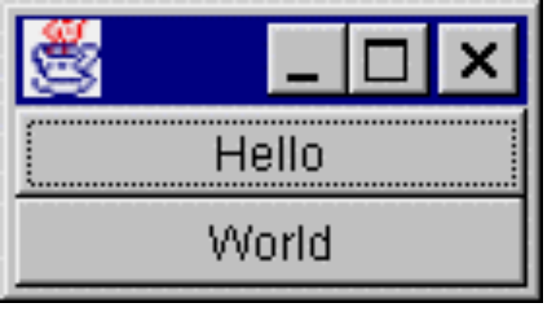
Swing vs. AWT 1.1
class MyActionListener implements ActionListener {
public void actionPerformed (ActionEvent e) {
System.out.println (e.getActionCommand());
}
}
...
ActionListener al = new MyActionListener();
Button b1 = new Button ("Hello");
b1.addActionListener (al);
add (b1, BorderLayout.NORTH);
JButton b2 = new JButton ("World");
b2.addActionListener (al);
add (b2, BorderLayout.SOUTH);

Slide 72
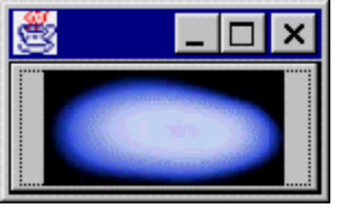
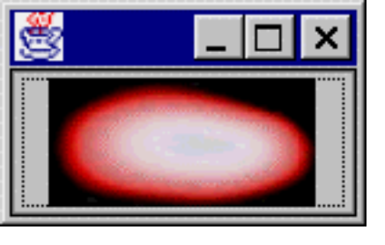
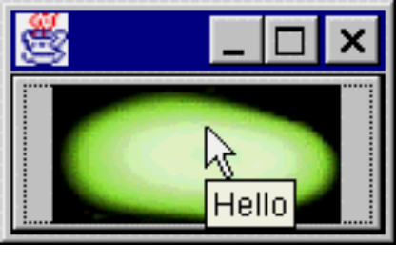
More on Swing’s JButton
import java.awt.*; import javax.swing.*;
public class MyFrame1 extends Frame {
Icon icon1 = new ImageIcon ("space01.jpg");
Icon icon2 = new ImageIcon ("space02.jpg");
Icon icon3 = new ImageIcon ("space03.jpg");
public MyFrame1() {
JButton b1 = new JButton (icon1);
b1.setPressedIcon (icon2);
b1.setRolloverIcon (icon3);
b1.setRolloverEnabled (true);
b1.setToolTipText ("Hello");
add (b1, BorderLayout.NORTH);
}
public static void main (String args[]) {
Frame f = new MyFrame1();
f.pack(); f.show();
}
}

Slide 73
JButton Enhancements
Image support
  Actually “Icon” support
  MediaTracker not required (w/ ImageIcon)
  Serializable
Separate Icons for different states
  Normal / Disabled / Disabled-Selected / Pressed / Rollover / Selected
ToolTip text
Keyboard accelerators for label

Slide 74
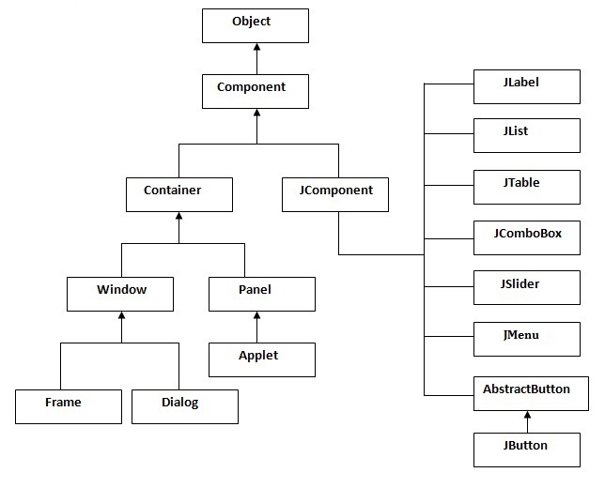
Swing Component Overview
Component Hierarchy

Slide 75
Swing Component Hierarchy
Container
  JComponent
    AbstractButton
      JButton
      JMenuItem
        JCheckBoxMenuItem
        JMenu
        JRadioButtonMenuItem
      JToggleButton
        JCheckBox
        JRadioButton

Slide 76
Swing Component Hierarchy/2
JComponent
  JComboBox
  JLabel
  JList
  JMenuBar
  JPanel
  JPopupMenu
  JScrollBar
  JScrollPane

Slide 77
Swing Component Hierarchy/3
JComponent
  JTextComponent
    JTextArea
    JTextField
      JPasswordField
    JTextPane
      JHTMLPane

Slide 78
More Components
FontChooser
JColorChooser
JDesktopIcon
JDirectoryPane
  JFileChooser
JImagePreviewer
JInternalFrame
JLayeredPane
  JDesktopPane
JOptionPane
JProgressBar
JRootPane
JSeparator
JSlider
JSplitPane
JTabbedPane
JTable
JToolBar
JToolTip
JTree
JViewport

Slide 79
Icons
A fixed-size image or glyph
Can be used with almost all components (e.g. JButton)
Icon is an interface that any class can implement
Icon used over Image because Image is asynchronously loaded and not serializable

Slide 80
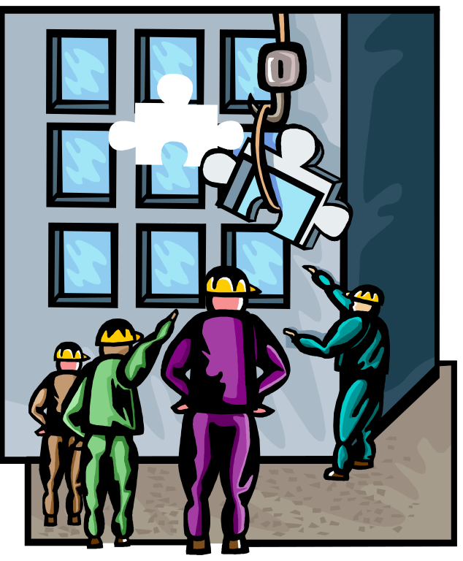
Swing Component Overview

Slide 81

Top Level Components
All subclass Window, not JComponent
Not lightweight, have peer
Components added to content pane
  RootPaneContainer interface - container delegate
Notes:
The top-level components within Swing are not peer-less, like the JComponent children. They require a heavy-duty component to subclass.

Slide 82
Using RootPaneContainer
No longer add components directly to top level containers
  aFrame.add (new Button (“Help”));
Add to “content pane”
  aJFrame.getContentPane().add (…);
  Layout manager too - default BorderLayout
JDialog, JFrame, JWindow, JApplet, JInternalFrame
Notes:
When adding components to a top level component, you use the getContentPane method, and it to what that returns. This method comes from the RootPaneContainer interface.

Slide 83
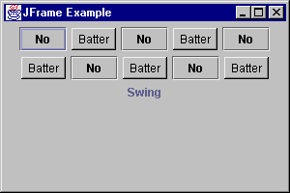
JFrame Example
public class FrameTester {
public static void main (String args[]) {
JFrame f = new JFrame ("JFrame Example");
Container c = f.getContentPane();
c.setLayout (new FlowLayout());
for (int i = 0; i < 5; i++) {
c.add (new JButton ("No"));
c.add (new Button ("Batter"));
}
c.add (new JLabel ("Swing"));
f.setSize (300, 200);
f.show();
}
}
Notes:
Working with AWT and Swing components can be no different.

Slide 84
JFrame Closing Behaviors
When user selects window manager Close option for JFrame, has default behavior
  Frame did nothing
  JFrame hides itself
setDefaultCloseOperation (operation)
  DO_NOTHING_ON_CLOSE
  HIDE_ON_CLOSE
  DISPOSE_ON_CLOSE
  No EXIT_ON_CLOSE operation
Notes:
The JFrame class acts a little differently than the standard Frame. It is no longer necessary to remember to associate a WindowListener to the frames.

Slide 85
JApplet
If using Swing components in an applet, subclass JApplet, not Applet
  JApplet is a subclass of Applet
  Sets up special internal component event handling, among other things
  Can have a JMenuBar
  Default LayoutManager is BorderLayout
Notes:
All Swing applets must subclass JApplet, not Applet. JApplet is a subclass of Applet, but it is necessary to perform some extra internals work before the component can do its thing.
A JApplet can also have a menu bar, which wasn’t previously mentioned.
And, if you were accustomed to your applet’s having the default FlowLayout, it is now based on BorderLayout

Slide 86
JOptionPane
Standard dialog boxes
  Yes, No, Cancel - or custom prompts
  Message
  Input
  Anything goes (you can specify everything)
  All dialogs are modal - blocks current thread
  String response =
  JOptionPane.showInputDialog(this, "Enter input:");

Slide 87
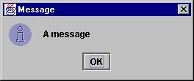
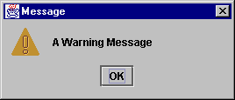
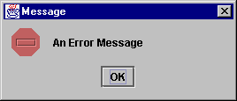
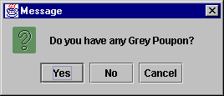
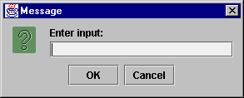
JOptionPane Examples

Slide 88
AWT Replacements
JLabel - like Label
  Still single line of text
  Also supports Icon, Border,
  Position text/icon in 9 areas, vs. 3 alignments
  Also position text/icon relative to each other
JButton - like Button
  Still single line of text
  Also supports Icon, positioning, ...
Notes:
Transitioning from AWT to Swing requires you to know what’s the same and different with the old environment.
JLabel and JButton are basically the same as before, supporting a single line of text. However, they offer many additional capabilities that were not previously available.

Slide 89
AWT Replacements/2
JPanel - like Panel
  Double-buffered (no JCanvas)
JCheckBox - like Checkbox
  JRadioButton for mutual exclusion group
    Grouped with ButtonGroup, not CheckboxGroup
JToggleButton - no AWT equivalent
  Provides a “stay pressed” state
  Great for tool bars
Notes:
The JPanel acts similarly to the Canvas object. There is no JCanvas object any more.
The JCheckBox doesn’t act like the prior beast (Checkbox). There are now two separate components for a single check box and a group of them.
The JToggleButton offers a third alternative, that has no AWT equivalent.

Slide 90
AWT Replacements/3
JComboBox - like Choice
  Editable - setEditable(boolean)
  Auto-initialize from array
    JComboBox jc = new JComboBox (aStringArray);
JList - like List
  Auto-initialize from array
  Scrolling not directly supported
    Must put in JScrollPane
Notes:
The JComboBox offers a Choice component with an editable option.
The JList control requires you to add it a JScrollPane to support scrolling.
Both JList and JComboBox allow you to initialize the controls with an array of objects (most likely text strings).

Slide 91
AWT Replacements/4
JScrollPane - like ScrollPane
  Scrolling component set in constructor or
  Container delegate
    Added to viewport / getViewPort().add()
  Can place objects in inner four corners, column headers or row headers
    Tables automatically use column header area

Slide 92
AWT Text Replacements
JTextField - like TextField
  Supports text justification
  JPasswordField for passwords
    Cannot clear/unset echo character
JTextArea - like TextArea
JTextPane - styled text support
JEditorPane - lightweight HTML/RTF editor/viewer
Notes:
The tree of text components within Java has changed a little. There are now special classes for inputting password and entering multi-styled text, as well as a simple HTML viewer.

Slide 93
ScrollBar Replacements
JScrollBar - like Scrollbar
JSlider - Scrollbar for picking values
  Display major / minor ticks
  Associate labels with ticks
Notes:
The JScrollBar is a run-of-the-mill replacement for ScrollBar. Of more interest is the JSlider which offers labeled values and tick marks, among other features.

Slide 94
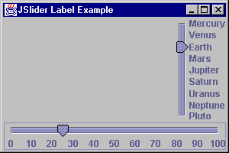
JSlider Example
JSlider right, bottom;
right = new JSlider(JSlider.VERTICAL, 1, 9, 3);
Hashtable h = new Hashtable();
h.put (new Integer (1), new JLabel("Mercury"));
h.put (new Integer (2), new JLabel("Venus"));
...
h.put (new Integer (9), new JLabel("Pluto"));
right.setLabelTable (h);
right.setPaintLabels (true);
right.setInverted (true);
bottom = new JSlider(JSlider.HORIZONTAL, 0, 100, 25);
bottom.setMajorTickSpacing (10);
bottom.setPaintLabels (true);

Slide 95
Menu Replacements
In JComponent class hierarchy
  JMenuBar - MenuBar (JFrame.setJMenuBar)
  JMenu - Menu
  JMenuItem - MenuItem
  JCheckBoxMenuItem - CheckboxMenuItem
  JRadioButtonMenuItem - no AWT
    Group with ButtonGroup
JSeparator - menu separator
  added by addSeparator
Notes:
Working with menus in Swing is a little different. No longer are the menu components in a separate class hierarchy. All components now subclass JComponent, the root of the Swing component set.

Slide 96
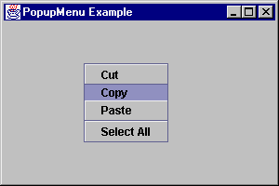
PopupMenu Replacement
JPopupMenu - like PopupMenu
  Added addSeparator method

Slide 97
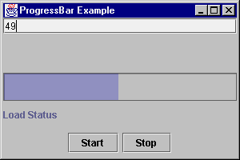
Progress Bar
Displays progress of operation
  Can be used like a gauge
Usage:
  Initialize
    JProgressBar progressBar = new JProgressBar();
    progressBar.setMinimum(0);
    progressBar.setMaximum(numberSubOperations);
  Go
    progressBar.setValue(progressBar.getMinimum());
    for (int i = 0; i < numberSubOperations; i++) {
    progressBar.setValue(i);
    performSubOperation(i);
    }
Notes:
The JProgressBar component is an interesting control that allows you to monitor the progress of some measured usage.

Slide 98
Tool tips
Context-sensitive text string that pops up when mouse rests over a particular object
JToolTip class supports this
  Rarely used
  Use setToolTipText method of JComponent
Singleton ToolTipManager manages tool tip operations

Slide 99
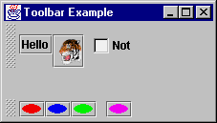
Tool bars
Display components in
single row/column
Can float or dock
Can contain any component
  Best if all the same, or similar type
  Consider using JToggleButton
Has addSeparator method
Notes:
JToolBar works with Actions, which will be described shortly.

Slide 100
Tabbed Pane
Tabbed panel control
Similar to using CardLayout with buttons for selecting cards
Use addTab to add components/panels

Slide 101
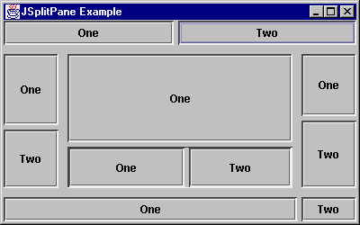
Split pane
Allows user-controlled resizing of two components
Can move divider programmatically with setDividierLocation
  int parameter
    absolute position
  float parameter
    percentage

Slide 102
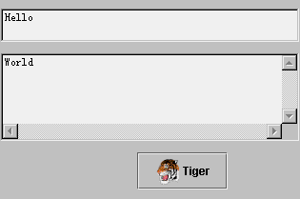
Box
Basically, a JPanel with a default layout manager of BoxLayout
  You specify direction
Offers non-visual components for spacing/stretching
  Glue and Struts

Slide 103
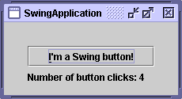
Building GUIs with Swings
Putting this in code:
import javax.swing.*;
public class MyApp extends JFrame{
private JButton b1;
private JLabel l1;
Public MyApp(){
super(“SwingApplication");
Container myCont = getContentPane();
b1=new JButton(“I’m a Swing button!”);
l1= new JLabel(“Number of button clicks: “ + num);
myCont.add(b1);
myCont.add(l1);
}

Slide 104
GUI components again…
JButton:
  JButton(Icon i)
  JButton(String s)
  JButton(Icon i, String s)
JTextField:
  JTextField()
  JTextField(int cols)
  JTextField(String s, int cols)
  JTextField(String s)

Slide 105
…and again…
JList:
  JList()
  JList(Vector v)
  Example:
  String[] data = {"one", "two", "three", "four"};
  JList dataList = new JList(data);
  dataList.add(“five”);

Slide 106
…and again
JRadioButton:
  JRadioButton(String s, Icon i, boolean state)
  Example:
  JRadioButton rb1= new JRadioButton(“one”);
  JRadioButton rb2= new JRadioButton(“two”);
  ButtonGroup bg= new ButtonGroup();
  bg.add(rb1);
  bg.add(rb2);

